Slide 1
Lane Detection
Zhanwei Zhang, Jianan Xie

Slide 2
Content
Background, Motivation, and Related Work
Innovation
Methodology
Experiment
Conclusion
Future Work

Slide 3
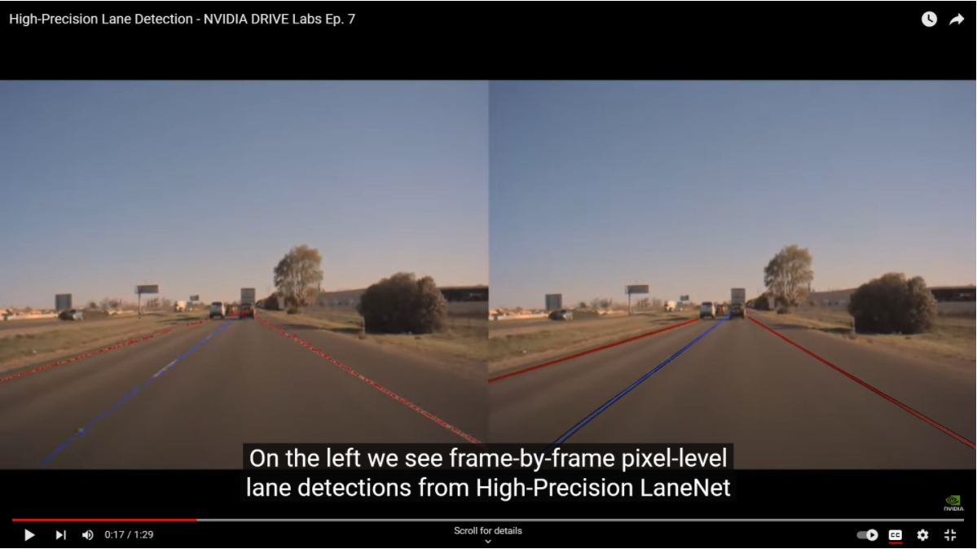
Background

Slide 4
Motivation
Visual Interferences
Environmental Variablility
Variety of Lane Markings
Missing Lane Lines
Multiple Lane Tracking
Road Changes

Slide 5
Related Work
Vpgnet[12] uses vanishing point estimation to improve robustness under various conditions.
A reliable CNN based regression approach[11] is used to detect thin and elongated lane boundaries.
A newly published work[3] based on transformer can learn BEV representations to eliminate the changes in road height.

Slide 6
Issues and limitations
model including post-processing stage can take high computational complexity[12].
many models only take ego lanes into consideration[8] or can only detect fixed numberof predefined lanes[15][11].
undulating terrain sets up big difficulties for lane detection.
Intuitively, learnable perspective transformation will overperform fixed one.

Slide 7
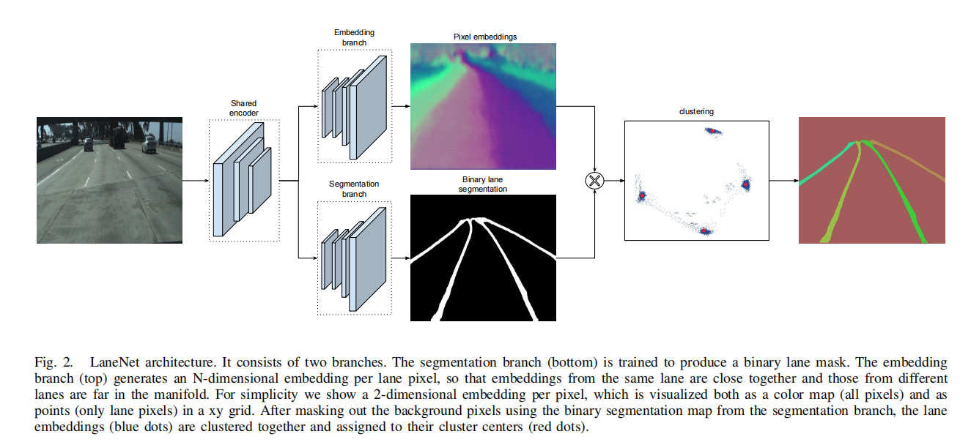
LaneNet Architecture

Slide 8
Initial Result
We observe the outcomes of applying a pre-trained model from a lane detection study to the SUSCape dataset as shown.

Slide 9
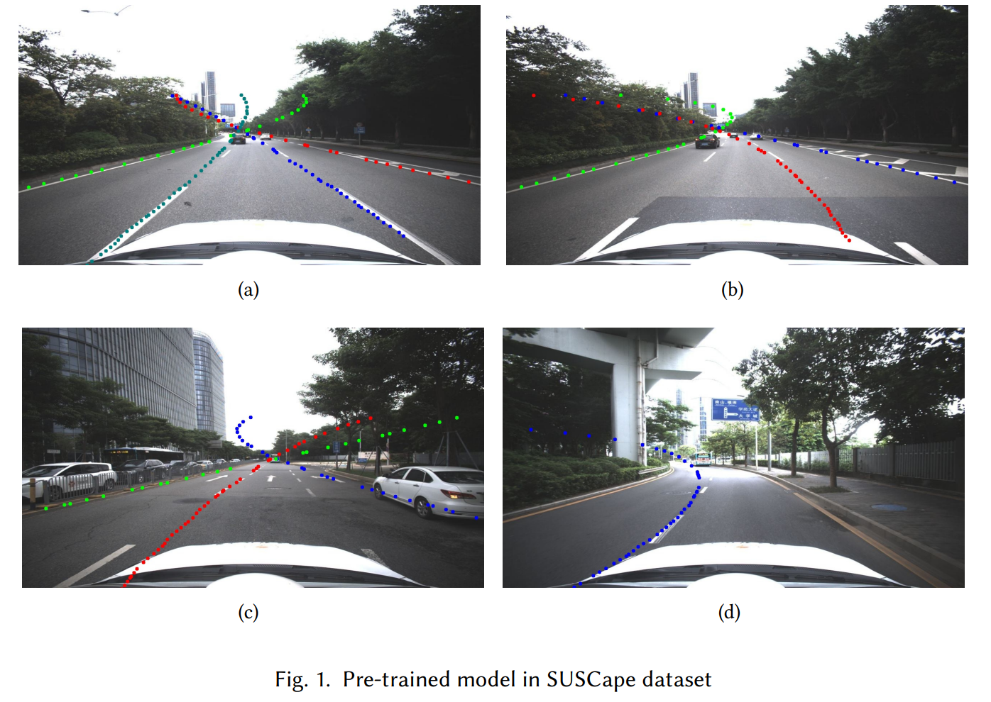
Initial Results

Slide 10
Initial Results
Primary issues were identified in the results:
Incomplete Lane Detection
Excessive Lane Fitting Extension

Slide 11
Innovation
Backbone Improvements
ENet
UNet
DeepLabv3+(Resnet101)
IPM(inverse perspective mapping) Improvements
H-net
Transformer(considering)

Slide 12
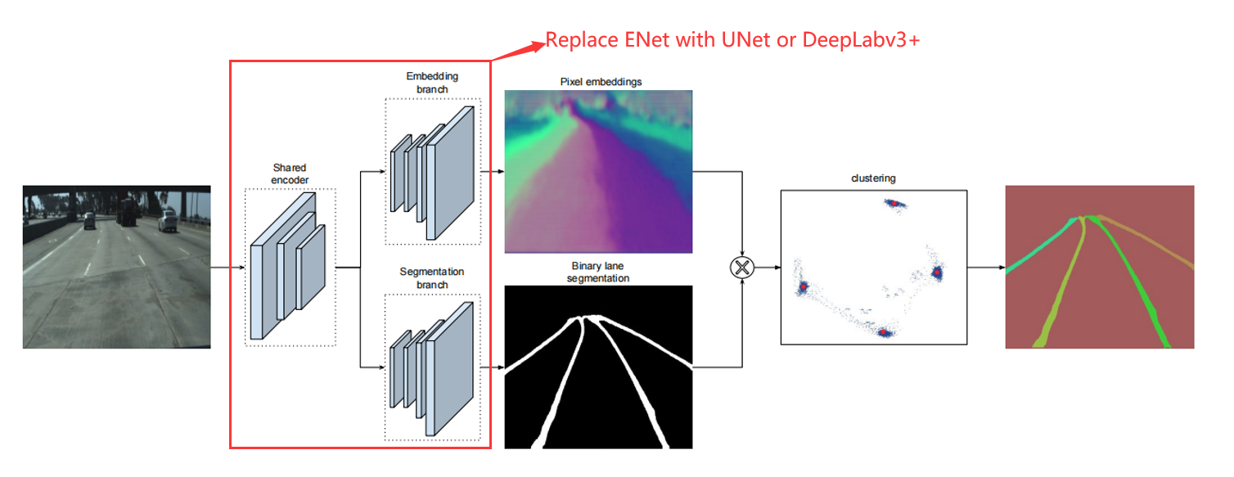
Methodology

Slide 13
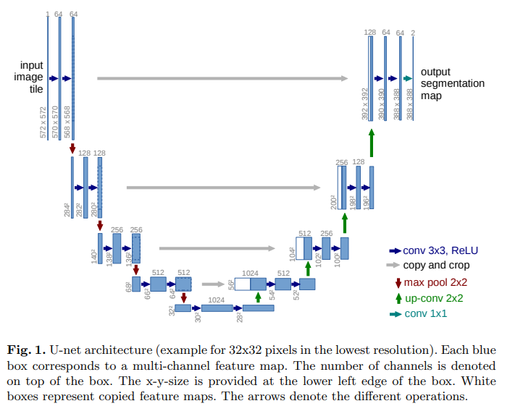
UNet
U-Net: Convolutional Networks for Biomedical Image Segmentation arXiv:1505.04597 [cs.CV]

Slide 14
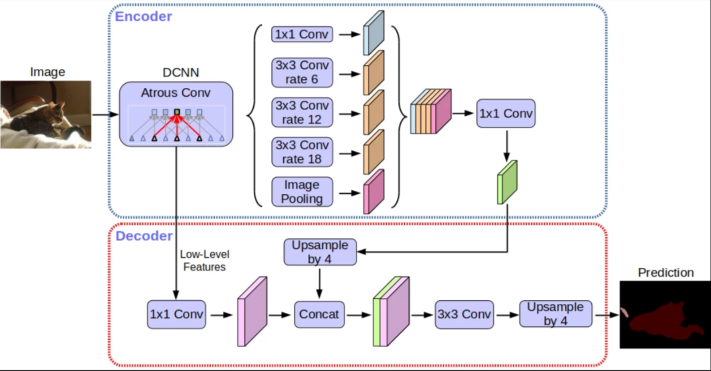
DeepLabv3+
[2] Liang-Chieh Chen, Yukun Zhu, George Papandreou, Florian Schroff, Hartwig Adam. Encoder-Decoder with Atrous Separable Convolution for Semantic Image Segmentation

Slide 15
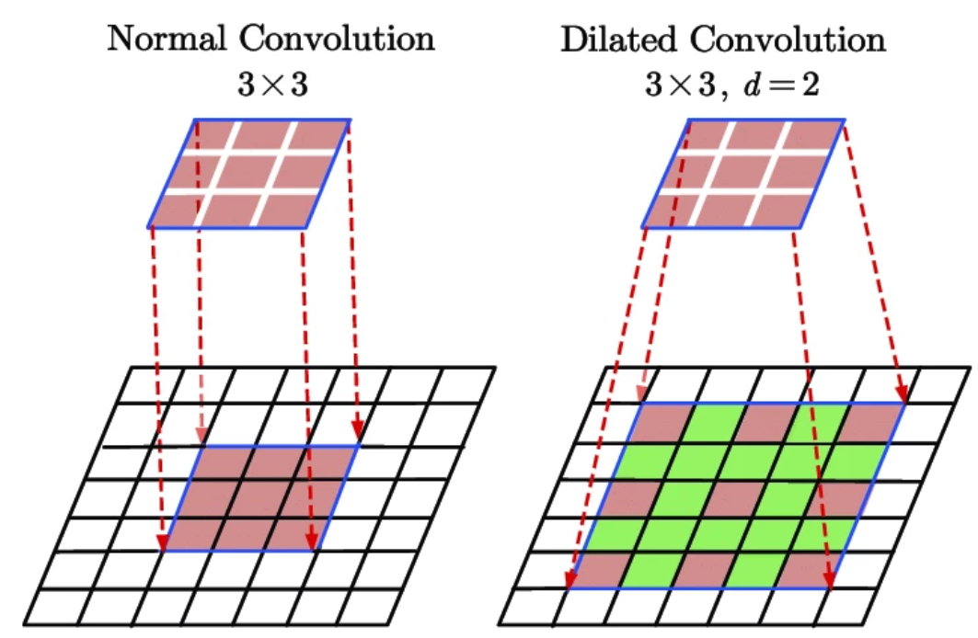
DeepLabv3+: ASPP

Slide 16
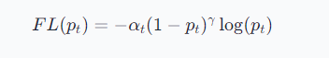
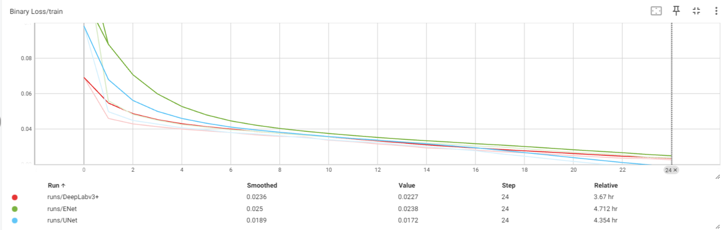
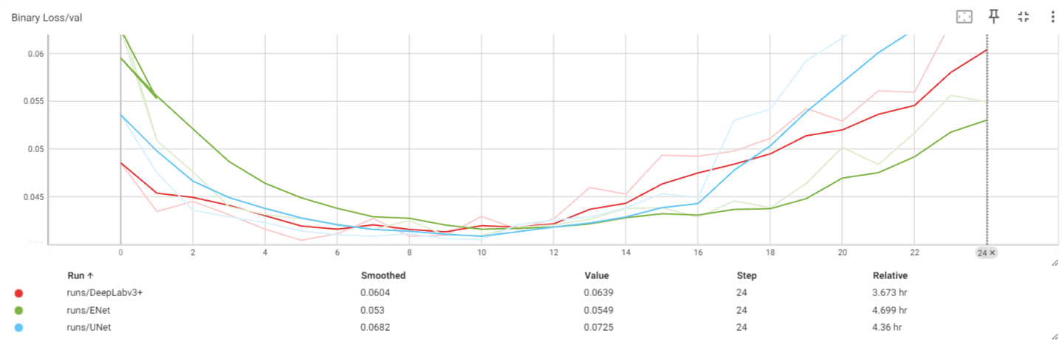
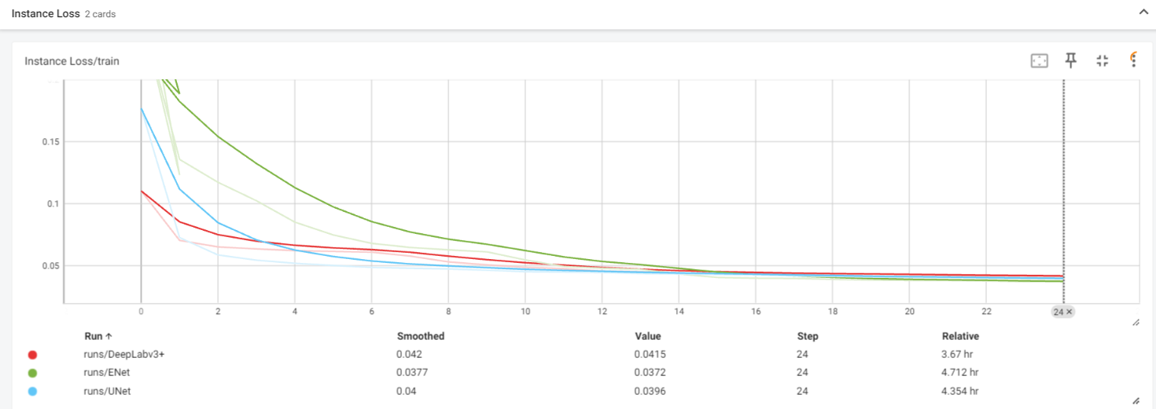
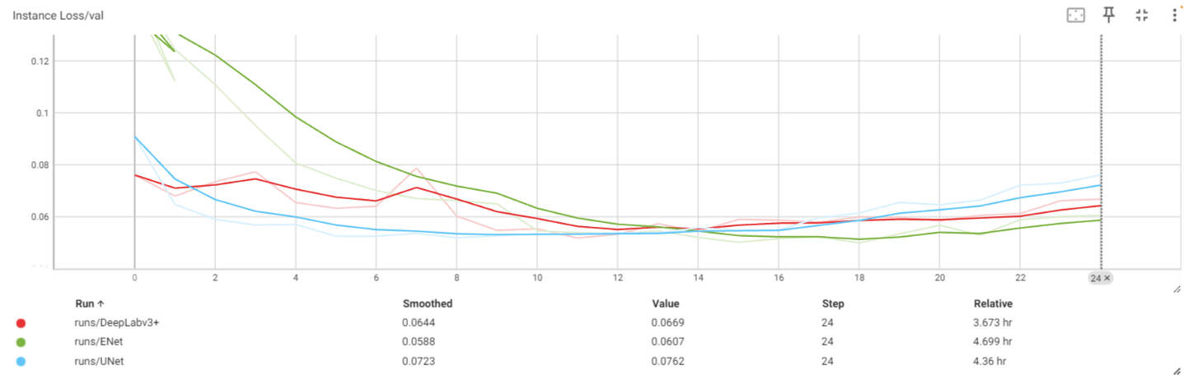
Experiment
We trained our LaneNet using UNet and DeepLabv3+ as backbone on TuSimple dataset respectively.(Epoch=25, Loss function=Focal Loss)

Slide 17
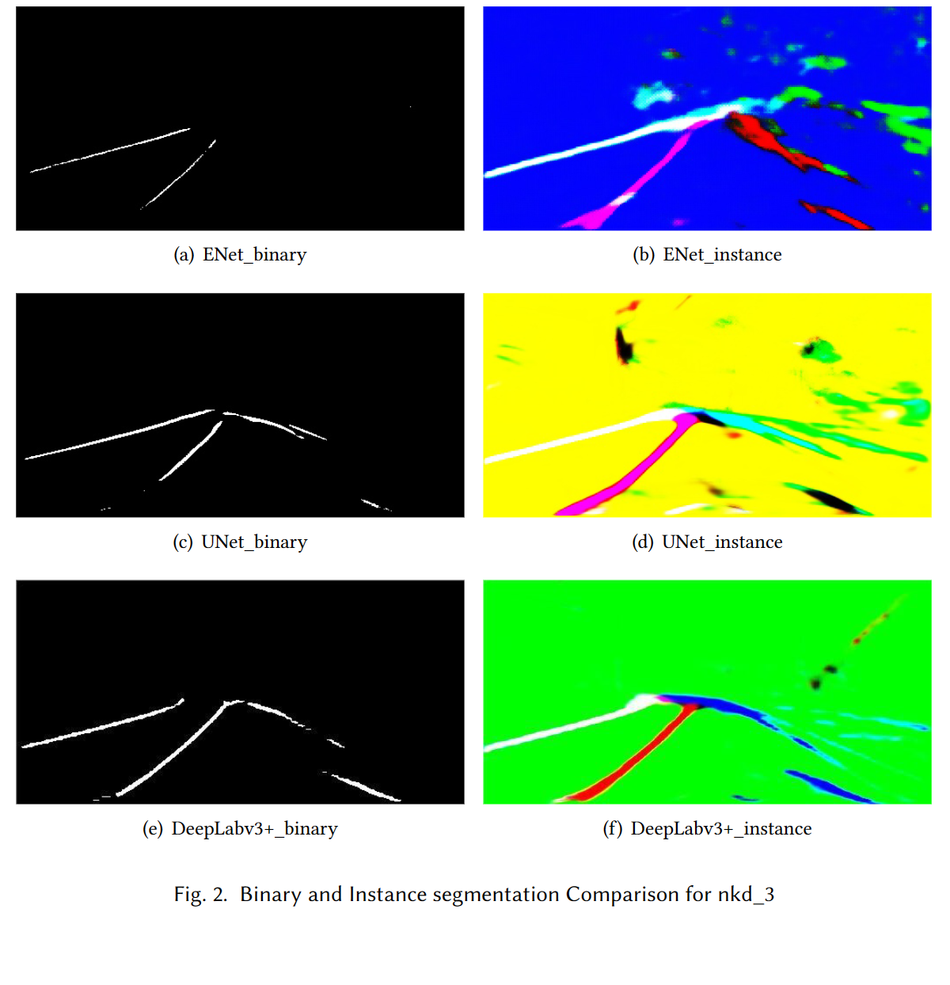
Result

Slide 18
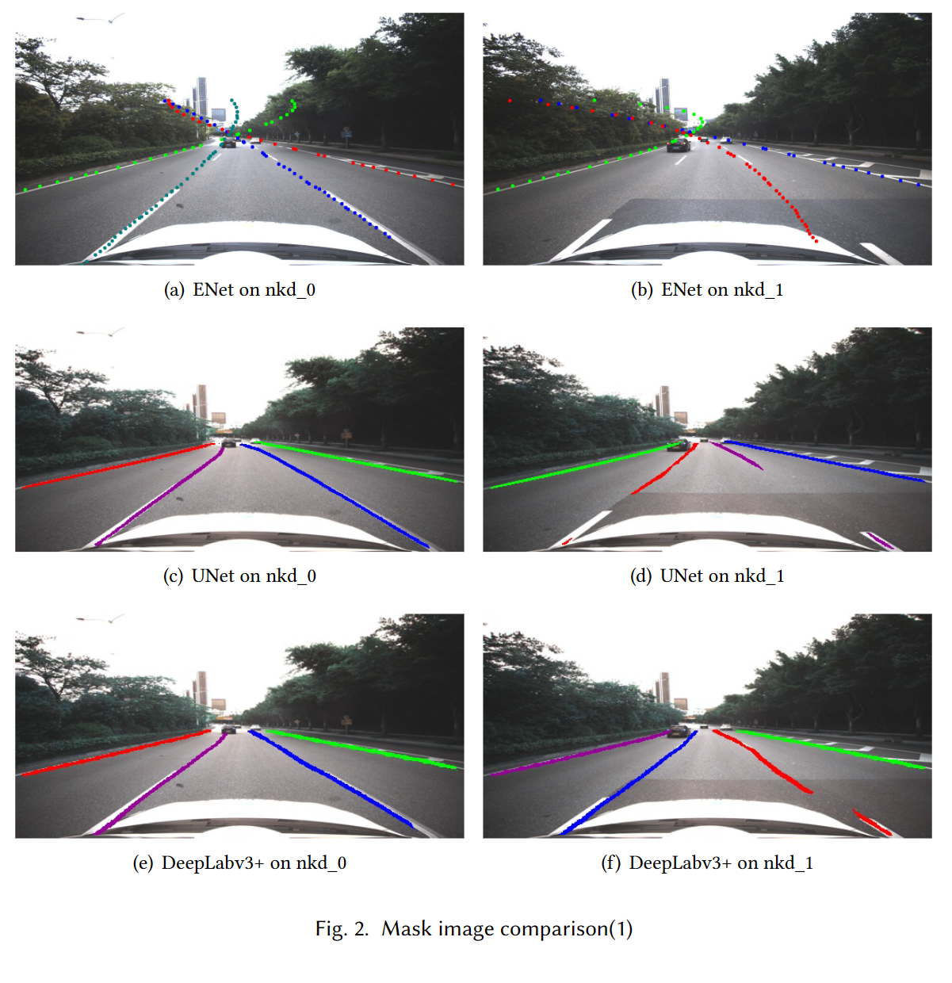
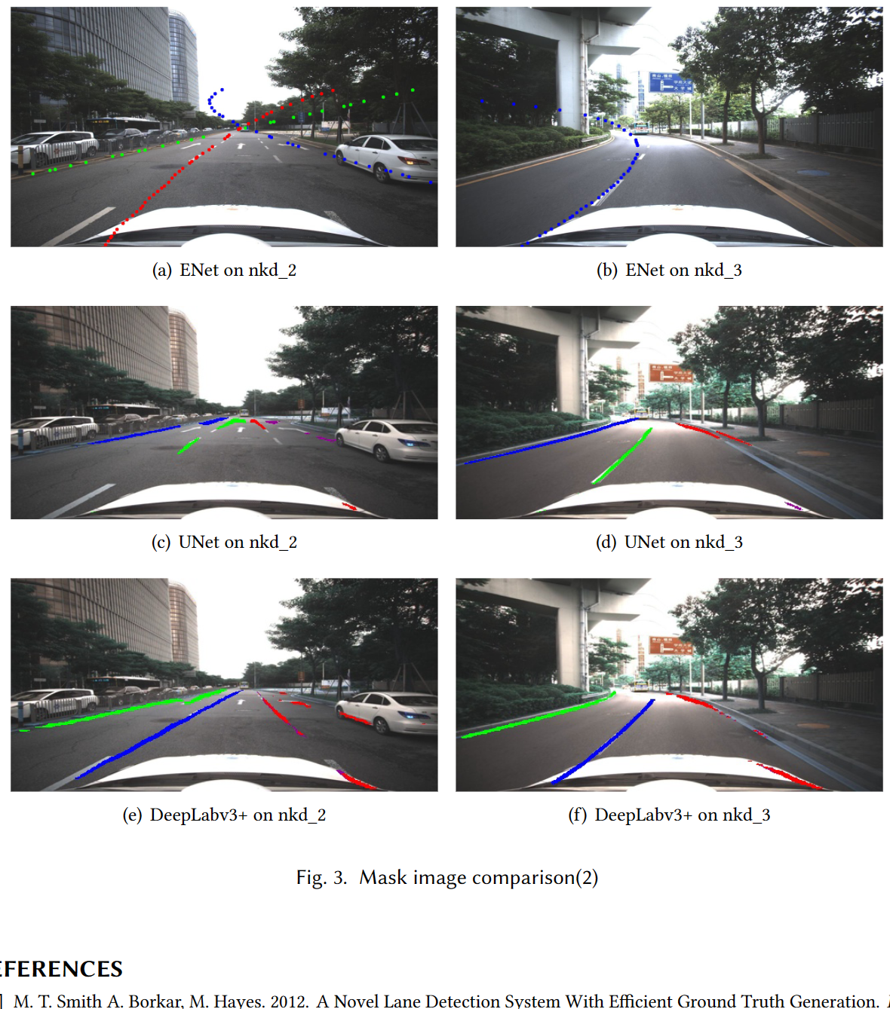
Result

Slide 19
Result

Slide 20
Conclusion
Our models overperform on real-word scenes than original Enet-based LaneNet.
DeepLabv3+ based model has more powerful ability to learn the structure of the lanes, and recognizes lanes well within 2~3s.

Slide 21
Future Work
Cope with the color mistakes
Try to use more powerful encoder-decoder model to learn the lane structure
H-Net

Slide 22
References
[1] M. T. Smith A. Borkar, M. Hayes. 2012. A Novel Lane Detection System With Efficient Ground Truth Generation. IEEE Trans. Intelligent Transportation Systems (2012).
[2] S. Kim E. Culurciello A. Paszke, A. Chaurasia. 2016. ENet: A deep neural network architecture for real-time semantic segmentation. CoRRabs/1606.02147 (2016).
[3] Ziye Chen, Kate Smith-Miles, Bo Du, Guoqi Qian, and Mingming Gong. 2023. An Efficient Transformer for Simultaneous Learning of BEV and Lane Representations in 3D Lane Detection. arXiv:2306.04927 [cs.CV]
[4] S. Reuter M. Szczot M. Konrad K. Dietmayer H. Deusch, J. Wiest. 2012. A random finite set approach to multiple lane detection. ITSC (2012).
[5] Z. Zhang et al. H. Zhang, C. Wu. 2020. Resnest: split-attention networks. arXiv:2004.08955
[6] Kaiming He, Xiangyu Zhang, Shaoqing Ren, and Jian Sun. 2015. Deep Residual Learning for Image Recognition. arXiv:1512.03385 [cs.CV]
[7] Ma Z. Liu C. Loy C. C Hou, Y. 2019. Learning lightweight lane detection cnns by self attention distillation. In Proceedings of the IEEE/CVF international conference on computer vision (2019).

Slide 23
References
[8] C. Park J. Kim. 2017. End-to-end ego lane estimation based on sequential transfer learning for self-driving cars. Proceedings of the IEEE Conference on Computer Vision and Pattern Recognition Workshops (2017).
[9] M. Xu P. Lv X. Zhao J. Niu, J. Lu. 2016. Robust lane detection using two-stage feature extraction with curve fitting. Pattern Recognit (2016).
[10] De Brabandere B. Georgoulis S. Proesmans M. Van Gool Neven, D. 2018. Towards end-to-end lane detection: an instance segmentation approach. IEEE intelligent vehicles symposium (IV) (2018).
[11] A. Ismail G. Adam V. Narayan M. Schulze S. Chougule, N. Koznek. 2018. Reliable multilane detection and classification by utilizing CNN as a regression network. Proceedings of the European Conference on Computer Vision(ECCV) (2018).
[12] J. Shin Yoon S. Shin O. Bailo N. Kim T.-.H. Lee H. Seok Hong S.-.H. Han I. So Kweon S. Lee, J. Kim. 2017. Vpgnet: vanishing point guided network for lane and road marking detection and recognition. Proceedings of the IEEE International Conference on Computer Vision (2017).
[13] Berriel R. Paixao T. M. Badue C. De Souza A. F. Oliveira-Santos T Tabelini, L. 2021. Keep your eyes on the lane: Real-time attention guided lane detection. In Proceedings of the IEEE/CVF Conference on Computer Vision and Pattern Recognition (2021).
[14] Mingxing Tan and Quoc V. Le. 2020. EfficientNet: Rethinking Model Scaling for Convolutional Neural Networks. arXiv:1905.11946 [cs.LG]
[15] D. Neven M. Proesmans L. Van Gool W. Van Gansbeke, B. De Brabandere. 2019. End-to-end lane detection through differentiable least-squares fitting. Proceedings of the IEEE International Conference on Computer Vision Workshops (2019).

